Slide 1
Winlink
Yet Another Introduction
And what to do with it.
Notes:
To get a feel of the audience and their awareness of digital stuff – things I may just take for granted might be new to some.
Ask how many have used Winlink (HF or VHF), FT8, JS8CALL, FLDIGI, FLAMP.
Ask what they have heard about Winlink.
Ask about digital using acoustic coupling and MT63, what information do you pass?
Ask about their SET exercise. #people, amount of planning
Ask about planned events. (unplanned too?)
Do you work with other agencies e.g. ARC. Hospitals, Point of Dispensing units, command posts, staging areas?
Now you are getting into some things that might require sending lists, status reports, requests
Now 100% accuracy is possible and routine.

Slide 2
What is it, really?
Not just another mode like Olivia or MT63
Not just a protocol like FT8 or JS8Call
Not just a Position reporting tool like APRS
Connection based system for messaging
  Two stations in an Automatic Repeat reQuest (ARQ) session
Complete system for world wide Email
  Store and Forward to any place
  Much redundancy
100% transfer guaranteed
Send attachments such as, Photos, PDF, spreadsheets, weather reports
Send standard forms such as Red Cross and ICS
Notes:
Most digital modes PSK-31, Olivia, etc. are one to many.
Explain FLAMP as series of blocks - lines - of a message each with its own CRC checksum
Each station initiates its own feedback.
Explain what a connection based system is. FT8 with a CQ – wait – respond – exchange - disconnect

Slide 3
Historical antecedents
Packet was developed for computer networks (early 1960’s)
  Used for VHF communications by hams (late 1970’s)
AMTOR was developed by hams to improve HF radioteletype (RTTY) communications (1970’s)
A Terminal Net Controller (TNC) performed the work of a computer and a MODEM
Pactor incorporates some of the best features of both (1990’s)
BBS systems
Maritime environment
Globalized using Internet
Notes:
Accurate information transfer was critical
The mission of Boat Watch is to maintain a worldwide network of resources to aid mariners that are missing or overdue; have a boat stolen; or to whom urgent messages need to be relayed. Winlink Global Radio Email is proud to be a partner of BoatWatch.org since 1999.

Slide 4
How to get started…
( Leave this for last ? )
Many web based resources
  PDF documents, YouTube Videos
Best all around source of information is Winlink.org
  https://winlink.org/content/winlink_book_knowledge
  Download and install Winlink Express,
  read the help.
  Play with it, then
  read the help again.
Notes:
There are three things to do
Audio in and out – select a soundcard then connect to
Capture device = Mic rename as HF Receiver Playback device = speaker, rename as HF transmitter
PTT to key your transmitter.
Rig control to set frequency, mode, bandwidth, power and so on
You can live without this but you have to set up your radio manually

Slide 5
Operation
Basic operation and modes

Slide 6
Basic Opeation
You register with Winlink and you get a mailbox that you can access anywhere
  Similar to Gmail or Hotmail or AOL etc.
  Someone from anywhere can send to you and you can pick it up anywhere else
  Only you do not need an internet connection to do it. Just a radio.
Amateurs simply use their call sign for an address.
  Able to send to other amateur operators or to any conventional Email address
  Any email protocol like POP…etc. is supported

Slide 7
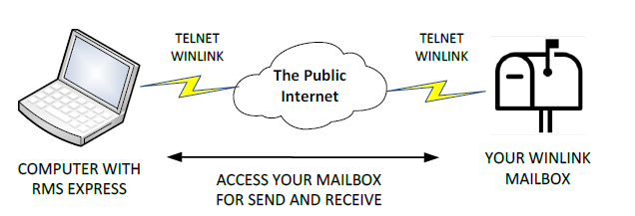
Simple and Very simple
COMPUTER WITH WINLINK EXPRESS
OR
COMPUTER WITH ANY WEB BROWSER
https://Webmail.Winlink.org:446
Notes:
No radio required. But you must be registered i.e. have an account
NOTE that the port number 446 is important. It wont work without it.

Slide 8
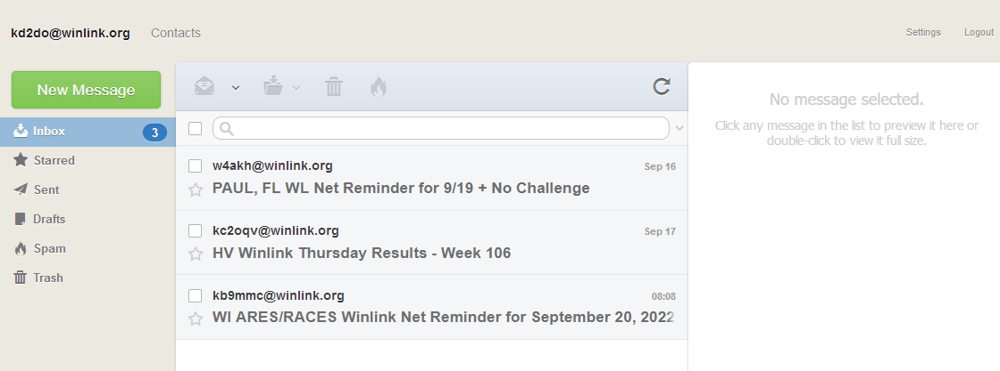
A browser view of my mailbox
Looks like any reasonable mail server
Notes:
The Winlink mail reader is a web based mail server. Not much different from Hotmail, Gmail, AOL etc

Slide 9
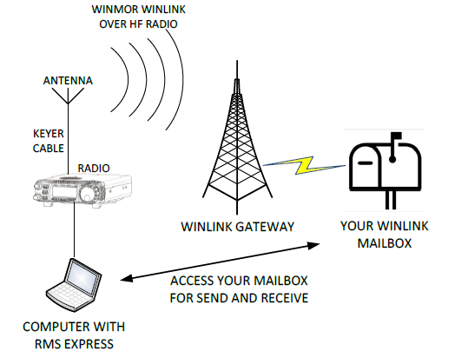
Radio is the first/last link (or mile) in the system
WINLINK OVER HF OR VHF RADIO LINK
Radio Message Server RMS
COMPUTER WITH WINLINK EXPRESS
Conventional
Notes:
This is the standard way of using Winlink Global Radio Email
The Yellow Flash is where all the magic happens: Internet, the cloud, central message servers, redundancy,
May use external soundcard interface between computer and radio

Slide 10


CMS
RMS
KB3PCY W2GSA N3HYM-10 WA3MEZ KD2DO-10
HF: Pactor, ARDOP, Vara (HF)
Robust Packet (Europe)
VHF/UHF: Packet, Vara-FM
Users
Notes:
Add pictures of maps for various services packet Vara vara-FM etc US and world wide
Use cloud picture only for CMS

Slide 11
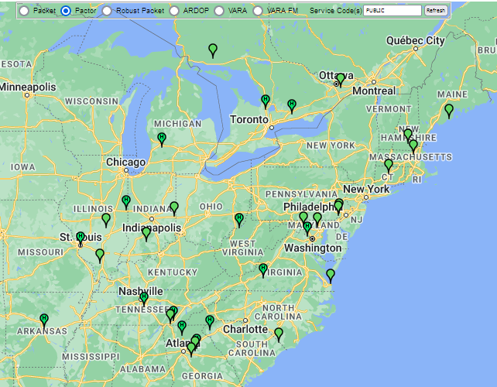
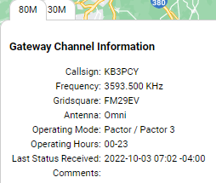

Slide 12
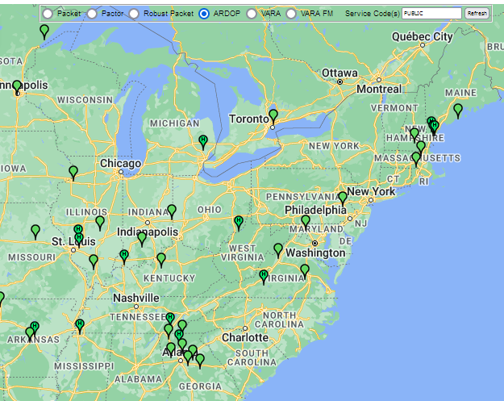
RMS stations
Using ARDOP

Slide 13
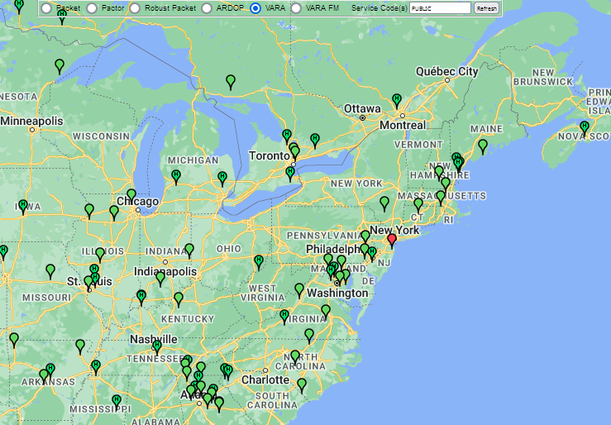
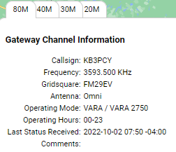

Slide 14
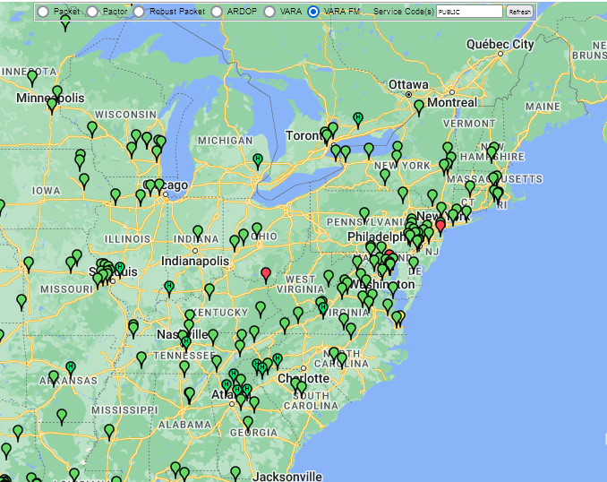
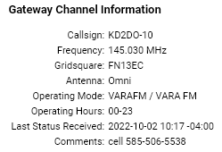

Slide 15
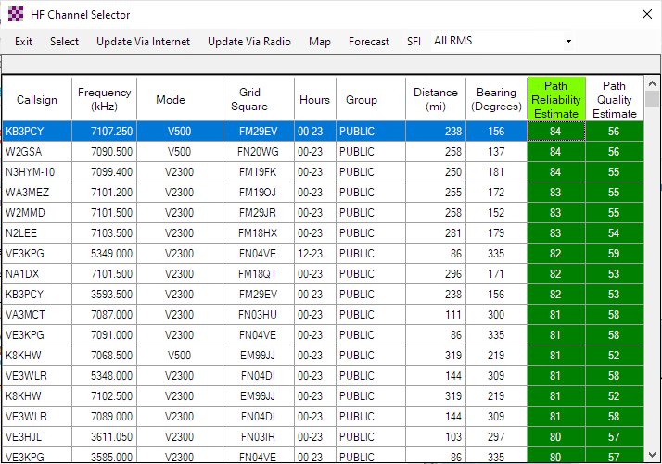
Notes:
Here is a typical HF channel selection window. Notice that Martin, KB3PCY has both a 40m and an 80m frequency.
He also has a 30m and a 20m frequency. Here you see his 40m spot is running Vara at 500 Hz BW while
On 80m he is running 2300 Hz BW.
When you have this window open you can sort on any column to sort up again to sort down
Remind me to show this when we bring up the radio.

Slide 16
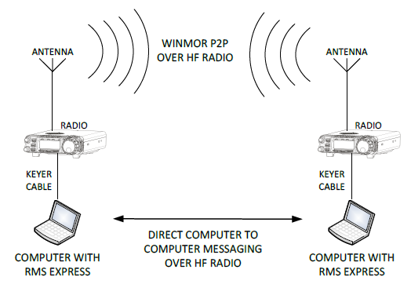
WINLINK P2P OVER HF OR VHF RADIO
Peer to Peer
COMPUTER WITH WINLINK EXPRESS
COMPUTER WITH WINLINK EXPRESS
Notes:
Peer to Peer, or Person to Person. Message transfer only not a “CHAT”. No internet involved.
Prepare your message ahead of time, then make connection.
There are some groups (more about this later) like Virginia and Florida in particular that have Peer to Peer sessions at given times.

Slide 17



Radio Only
No Internet
RMS
HF links using Pactor or Vara
RMS
RMS
Notes:
Radio-Forwarding Mode – Conventional mode is reliable and efficient, but it relies on
an Internet connection between the RMS and a CMS. If an RMS is running strictly in
conventional mode, and it doesn’t have an Internet connection, it cannot accept
connections from client stations and route them to a CMS. If the Internet outage is
confined to the local region of the RMS, a client can simply select a different RMS that
has Internet to reach a CMS. However, with the increasing risk of network hacking and
cyber-attacks, there is a growing concern with the vulnerability of the Internet itself. By
policy, some government sites are prohibited from connecting to the public Internet out
of fear of hacking attacks.
The term “Hybrid Mode” refers to an RMS configured to operate in Conventional Mode
when it has Internet access and to switch automatically to Radio-Forwarding Mode if it
loses the Internet connection.
For testing and exercises, messages can be composed and sent into a Hybrid RMS as
“Radio-Only Messages.” Because of the way these messages are tagged and the
type of connection made to the RMS, these messages are forced to be handed using
radio-forwarding mode even if the Internet is available.
Message Pickup Stations (MPS)
Messages transferred by radio-forwarding are not stored on a CMS. Instead, they are
forwarded to an RMS and stored in its local database for the recipient to download.
Since it would be impractical to send a copy of every radio-forwarding message to
every RMS, the recipient must designate which RMS he wants to use as his Message
Pickup Stations (MPS). This designation must be done at least 24 hours before radioforwarding
will be available for them.

Slide 18
FORMS
Structure your messages for pretty printing
And delivery to served agency
Notes:
There are some other things in the Winlink system such as Position Reporting, and an interface with APRS
I will touch on those later.
As Winlink began to grow and move into the Emergency Communications realm people found that FORMS
were often needed for served agencies
This is one of the biggest features of Winlink Express and as you will see it is very diverse in its application
The way forms work is:
the sender brings up an HTML document with the fields blank.
Then the sender fills out the form.
Just the name of the form, the name of the field, and content of the field are extracted and transmitted.
The receiver already having that blank form, opens it and populates the fields with the received data.
The receiver prints the completed form and hands it to the served agency.

Slide 19
Forms
Many many to choose from
ICS
Red Cross
California
Oregon
Washington
Hawaii
Texas
Canada
Radio Relay International
Radiogram
Send SMS/Text message
Notes:
Health and welfare messages are important
After the Hurricanes in Puerto Rico
People wanted to know if friends and family members were safe.
You may have heard that the FCC gave its blessing to use Pactor 4 to speed up the passage of Data traffic like this.

Slide 20
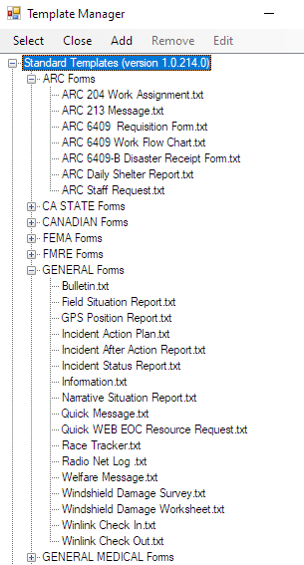
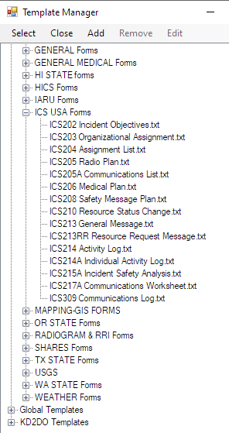
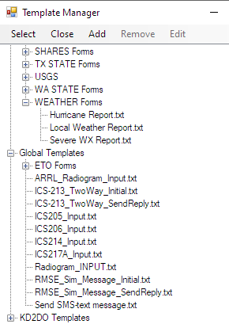
Notes:
Here are some of the hundreds of forms that are built into Winlink Express.
Whenever some form is updated, Winlink sends a notice to all users everywhere to update their forms.
5 seconds later you are up to date.

Slide 21
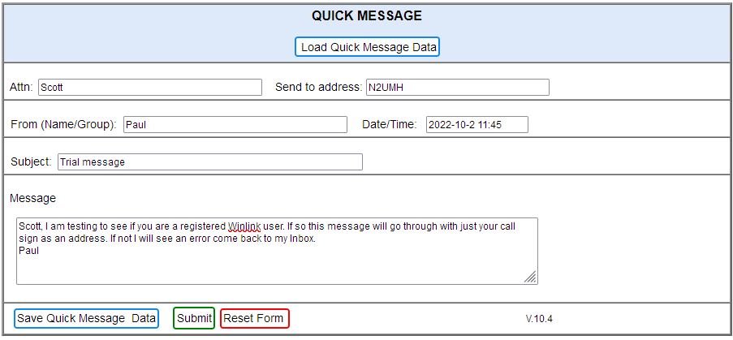
Notes:
Once you select a form (also called a template), it loads the HTML form into your default browser and displays it to you.
You then fill in the blanks then Submit the form.
It will make a note of the form you used, the version of it, and your callsign,
then will extract just the text you entered. This is all that needs to be sent.

Slide 22
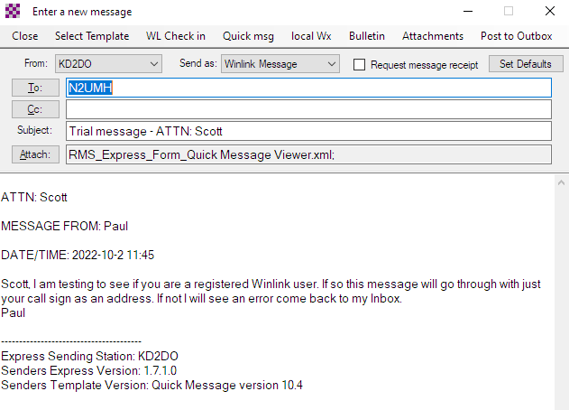
Notes:
This is the message window after the form has been submitted.
You can edit it, add or change addressees, and Cc addresses, or change from Winlink to P2P mode.
Then Post to your Outbox
And await the next connection to an RMS.
I can open a session of whatever mode is available on VHF or HF
As soon as the connection is established the message (everything in my Outbox) is sent.

Slide 23
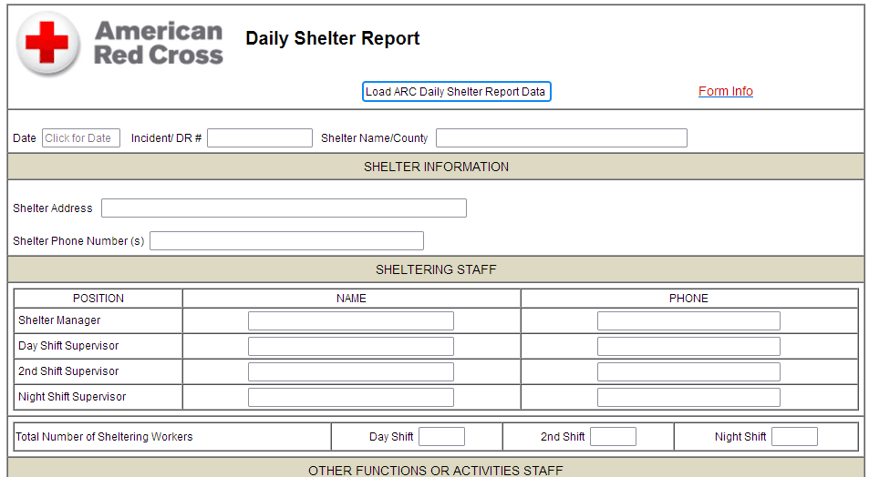
Notes:
Page 1 of 2

Slide 24
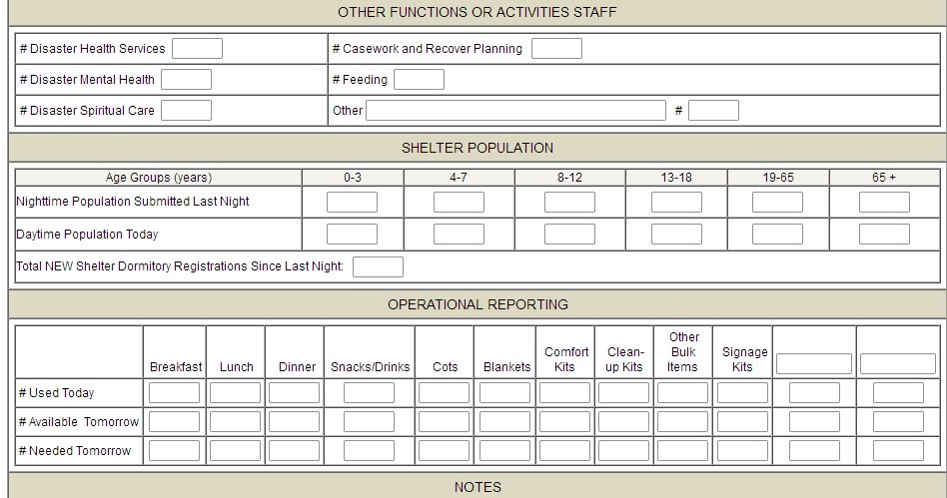
Daily Shelter Report (continued)

Slide 25
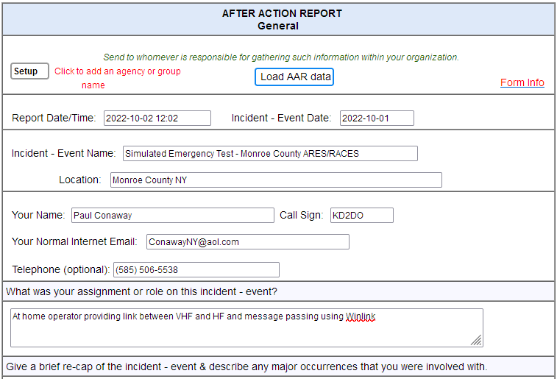
Notes:
We had an S.E.T. exercise not long ago. They asked for an after action report. There is a nice form for doing that.

Slide 26
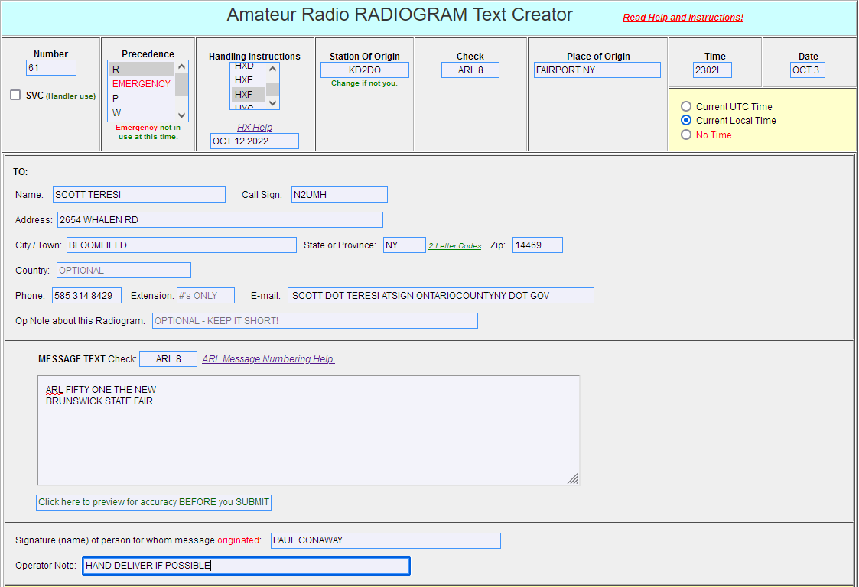
Notes:
I have to remind folks that long, long before there was ICS to standardize things there were amateur radio operators out there cleaning up hurricanes, sending welfare check messages, ordering supplies for relief efforts, and so on. They developed the Radiogram, and the nearly 50 Standardized ARL message shortcuts that are still used. It seems that a lot of the forms we talk about now are just expanding on those common messages and adding details.
I think that use of the basic radiogram is often overlooked and therefore under used.
ARL Numbered Radiograms
Numbered messages have been established for some of the more common texts sent during emergencies and holiday seasons. When this common text can be used, an ARL NUMBER is substituted for the text and sent. The delivering station reads the actual text to the address, not the ARL NUMBER.
Insert ARL followed by the number. Example ARL FORTY SIX

Slide 27
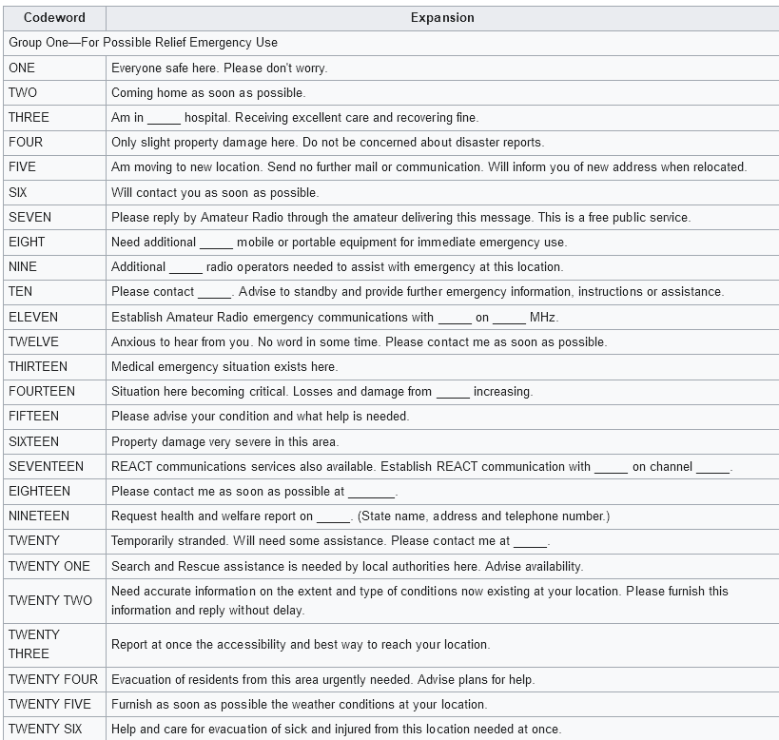
Group one
26 common, standardized messages
For
Relief and
Emergency Use
Notes:
ARRL Numbered Radiogram
From Wikipedia, the free encyclopedia
An ARRL Numbered Radiogram is a brevity code used in composing ARRL Radiograms during times of radio congestion.
The code is used to transmit standard messages, sometimes with customized text, very quickly by experienced ARRL National Traffic System (NTS) message traffic handlers.
In use, ARRL Numbered Radiograms are messages encoded as one or two numbers. The numbers are always written down as words, and are always preceded by the procedure word "ARL". Throughout their transit in the Amateur radio National Traffic System, they retain this format and are only expanded to their plain-English meaning when delivered by a Ham. For example, "ARL FORTY-SIX" would be typed in a letter or spoken over the phone to the addressee as "Greetings on your birthday and best wishes for many more to come.“For those codes where customized text can be added, the customized text is added immediately following the number code word. For example, "ARL SIXTY TWO CHRISTMAS" is expanded upon delivery outside of the NTS System as "Greetings and best wishes to you for a pleasant Christmas holiday season."

Slide 28
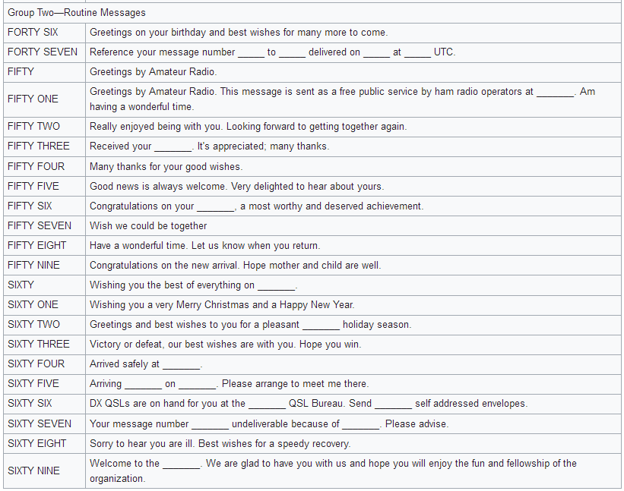
Group two
22 common messages for Holiday Seasons
and
Routine Messages
Notes:
See also:
https://www.arrl.org/files/file/Public%20Service/MPG104A.pdf
http://w1npp.org/ares/NTS/NTSCheatSheet.pdf

Slide 29
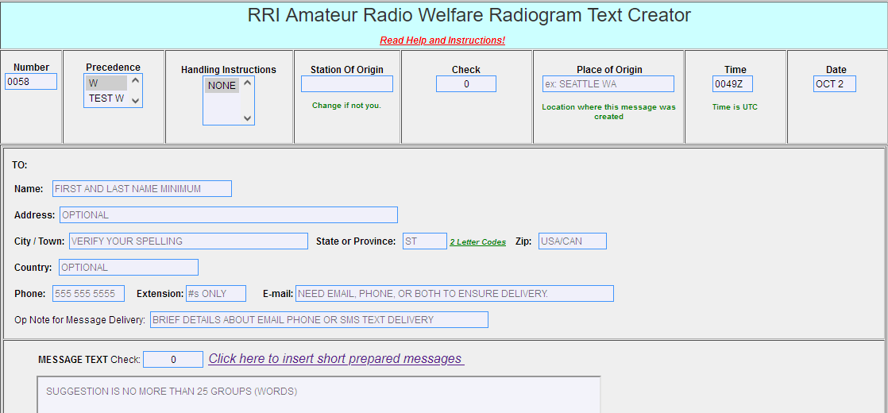
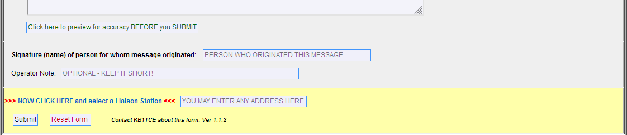
Notes:
Radio Relay International is the digital version of the National Traffic System which is voice.
The Amateur Radio Welfare Radiogram Text Creator
The Winlink Express Amateur Radio Welfare Message Text Creator is a special purpose adaptation of the general purpose Amateur Radio Radiogram Text Creator. It is fully compliant with the amateur radio radiogram format but includes some special features and excludes items that are not necessary.
This Text Creator template is intended for brief outbound Welfare/Safe and Well communications from a person in a disaster area to family/loved ones. There are a couple of differences from the standard general purpose Radiogram Text Creator template:
The preamble is simplified. Precedence is restricted to Welfare and Test Welfare, there are no handling instructions and UTC is autofilled as the time of origination.
There is a list of suggested short messages that may be inserted into the message text. These are, in some part, derived from the American Red Cross Safe & Well list of short texts. In the drop down list, clicking on any item will transfer the text into the message pane;. More than one standard text can be added as well as free text but the check should still stay within 25 groups.
DEMO (later) to show this form and the Help and Instructions

Slide 30
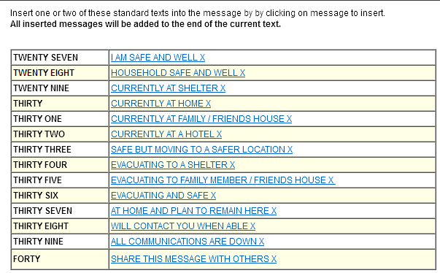
Notes:
Note the number range for these codes

Slide 31
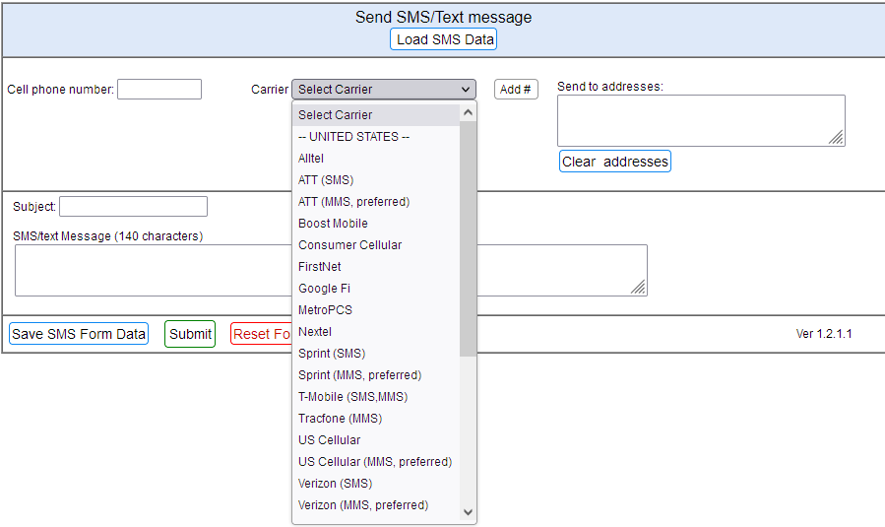

Slide 32
How to get more practice
Who can I talk to?
How do I learn using Forms?

Slide 33
Routine Practice Sessions
Winlink Wednesday etc.
https://winlinkwednesday.net
  Send a simple message via Winlink on Wednesdays
  Send a P2P message during certain Hours on Wednesdays
http://wi-aresraces.org/winlink_net.htm Wisconsin ARES/RACES
  Send a simple formatted message on Tuesdays
https://w4akh.net/ Florida Winlink net W4AKH
  Accepting messages all week, P2P messages at specified times
The Hudson Valley WinlinkThursday Net. Look for Sullivan County ARES on Facebook
South New Jersey SNJ Winlink Wednesday run by NJ2N Tim NJ2N@arrl.net
Great Lakes Winlink Wednesday KB8RCR
Rochester’s own Winlink Workday VHF local only (occasional)
Notes:
The primary purpose of Winlink Wednesday is to encourage the regular use of the Winlink
system among amateur radio operators by providing an opportunity to expand their skills with
Winlink, and to practice them on a regular basis. My purpose is to keep users sharp so that, if
and when a served agency calls on us, we can perform confidently and professionally. Although
previously aimed primarily at Virginia amateur radio operators, participation from outside of
Virginia now comprises more than half of each week’s check-ins, including nearly every US state
and dozens of foreign countries.
I have been doing these so often that I made up my own Templates (macros) to populate the standard response to these.

Slide 34
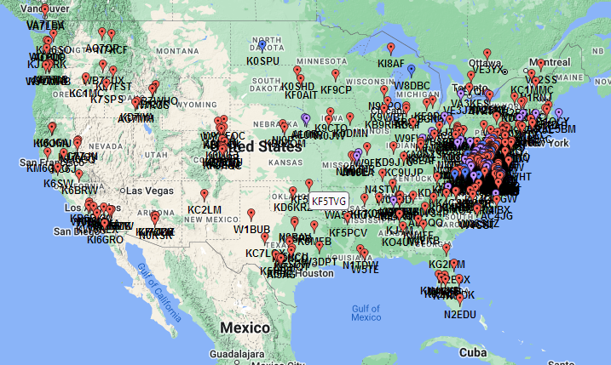
Virginia’s
Winlink
Wednesday
9/28/22
Notes:
And a dozen in Europe, Australia, New Zealand, South America, Puerto Rico, Alaska
Note that this is NOT a tracking of RF contacts but merely of the word of mouth influence of winlink and the desire to learn about it.

Slide 35
Winlink Workday
Local VHF users only
Any day you feel like it – I’ll read them on Thursday
First told everybody to tell me their Lat –Lon coordinates
Then in different coordinate systems
What3words.com/serious.foreground.prompting
Using Google Earth find the distance and bearing from you to the Winlink machine
Using the coordinates of fellow users what is the Coverage Area.
Then use of some of the forms
Making your own templates
Notes:
DEMO the What3words.com/serious.foreground.prompting

Slide 36
Position Reporting
Monday, September 05, 2022
8:55 PM
In Winlink go to settings >> GPS/Position Report (5th line from top)
Use degrees and Decimal minutes like this From Google Earth
Latitude: 43-3.03N
Longitude: 77-25.18W
Add short comment like what frequency/mode you are monitoring
Then Post it. It goes to the Outbox. Send it from there.
To see who else is nearby (500 miles or so) send another message
To: INQUIRY
Subj: REQUEST
Message body: WL2K_NEARBY
Then wait about 3 minutes and go look for a reply.
Comments appear in Winlink record as well as APRS.fi
Ontario County Safety Training Center 42-53.441N 77-13.137W
Notes:
Using winlink you can send out your position and a short comment. This will show up on BOTH the APRS.FI and winlink.org/userPositions web pages. One additional thing Winlink can do is give you a list of all nearby stations who have reported their positions within the last 10 days.
One example given was after the hurricane in Puerto Rico operators would send their new locations via HF of course and say they were monitoring JS8Call on 40m, or monitoring some frequency at specific hours. Pretty handy for emcomm eh? Even if you don't have a GPRS machine on VHF nearby to use, you can do the same with Winlink.
Remember to demo and show map

Slide 37
APRS link
There is a full APRS gateway hosted on the Winlink CMS
It allows APRS users to Access their Winlink Global Email.
Works with Kenwood TH-D7 or TM-D700/710 devices
APRS users can:
Read and send short 1 line messages
Do email maintenance – list, forward and delete messages etc.
Find the closest RMS gateway
Get APRS notification of incoming Winlink mail
Notes:
APRSLink
APRSLink is a CMS-Hosted gateway providing a link between the Automatic Packet Reporting System (APRS) and the Winlink global radio email system. APRSLink monitors all APRS traffic gated to the internet, worldwide, and watches for special commands that allow APRS users to:
read short email messages sent to their callsign@winlink.org account (only the base callsign, no SSID)
send short email messages to any valid email address or Winlink 2000 user
perform email related maintenance (see commands below)
be notified of pending Winlink email via APRS message
query APRSLink for information of the closest Winlink RMS packet station

Slide 38
(take a break ? )
Now for some demonstrations
Show radio with both VHF and HF connections, battery, speakers
Launch Winlink Express
Send Gettysburg address to 4 people using 4 modes
Browse forms. Find RRI welfare / help
  Winlink Checkin
  Radiogram and RRI version see help page
  Whole series of ICS forms
Send a Position report
  Find out who else is nearby, see on map.
Notes:
As I bring up Winlink notice that it is the modem – Ardop, Vara, Packet etc. that handles the connection to your radio.
Often times when you plug the serial port adapter into a different USB port on the computer the assignments will change.
(COM1 to COM3 for example) so when setting up the first time, check.

